Slide 1

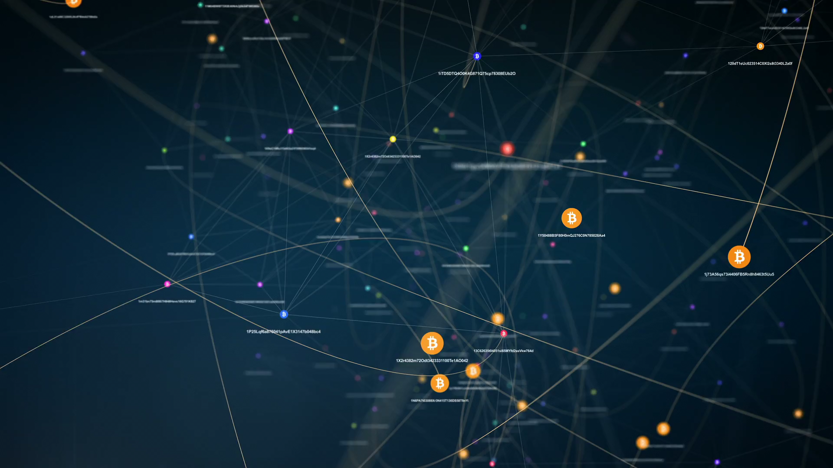
BLOCKCHAIN TECHNOLOGY
Index:

Slide 2
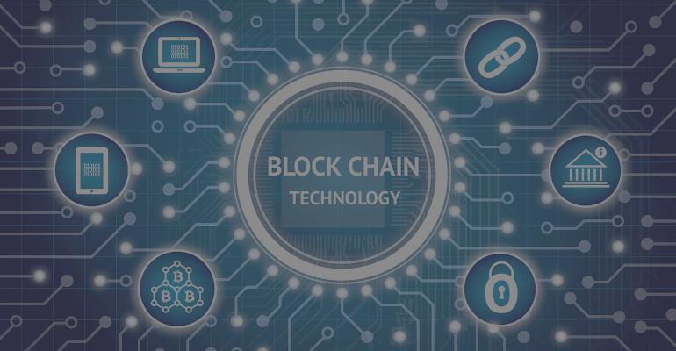
Issue with current Banking System and overcome them with Blockchain
No Transaction fees
The Ledger is public
High Transaction Fess
Private
Ledger
Prone to
Hacks
Double
Spending
Immutable to
Hacks
No Double
Spending

Slide 3

What is Blockchain Technology ?
Peer-to-peer network
Block
1
Cryptography
Transaction
Digital Signature

Slide 4

Blockchain Flow Diagram
Request a Transaction
Broadcasted in network
Verification
Transaction Completed
Block is Added
A new Block is made

Slide 5
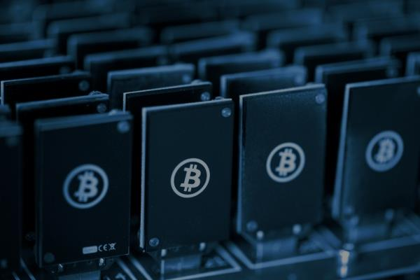
Blockchain Types
1.Public
Private
Public
2.Private
3.Consortium
Consortium

Slide 6
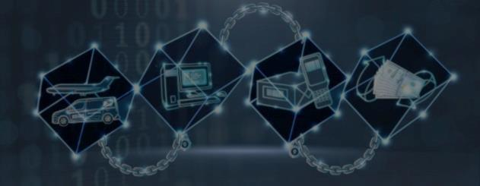
Conclusion
1.Future of Block chain technology
2.Decentralized
3.Mainly used in Banking
4.More Secure

Slide 7

Key Characteristics of Blockchain
Decentralized systems
A distributed ledger
Safer and secure ecosystem
Minting

Slide 8

Real-World Uses for Blockchain Technology
Payment processing and money transfers
Monitor supply chains
Retail loyalty rewards programs
Digital IDs
Data sharing
Immutable data backup
Tracking prescription drugs

Slide 9

Application of Blockchain beyond Cryptocurrency
Voting
Supply chain management
Accounting
Stock exchange
IoT

Slide 10

Reference

